Slide 1

100GbE Switches - Do the Math
Open Compute Project Engineering Workshop
June 2016

Slide 2
What’s Good For Hyperscale, Works at Smaller Scale
Monolithic proprietary Chassis ➔ Leaf Spine
  No reason to pay more and use a proprietary, vendor specific hardware
  Six-pack? Leaf-Spine in a box
Switch-switch mLAG ➔ OSPF or BGP, depends on scale
  Ability to scale without changing network design, multi-vendor
Stacking ➔ Managing switches just like managing servers
  Ability to scale without dependency on vendor’s proprietary features
  Reducing control plain? Avoiding “noisy” OSPF? Use BGP
  Hard to manage, don’t have many Linux developers? Variety of tools making it very simple

Slide 3
What’s Good For Hyperscale Works at Smaller Scale
Single speed cable ➔ break out cables
  One port down ➔ 4 server down? 10-1000s Years MTBF passive DAC, mLAG in a rack…
  More expensive? Actually not, break out cables save money
Many different switches ➔ one or two building blocks
  Using a 32 x 100GbE as a multi-purpose switch, saving $ using a 48+4/6/8 ToR
10GbE → 40GbE or 25GbE → 100GbE ➔ 10GbE → 100GbE
  10GbE servers with 100GbE uplinks saves $

Slide 4


From 10-40GbE to 10-100GbE
Network
40GbE
Network
25% Higher Bandwidth
100GbE
Similar Connectors
Similar Infrastructure
10GbE
10GbE
10GbE
>10GbE
28 racks
28 racks
Similar Cost / Power
Compute Nodes
Compute Nodes
Compute Nodes
Compute Nodes
25% more bandwidth Leaf➔ Spine
Less spine switches
Less uplinks – better bandwidth

Slide 5
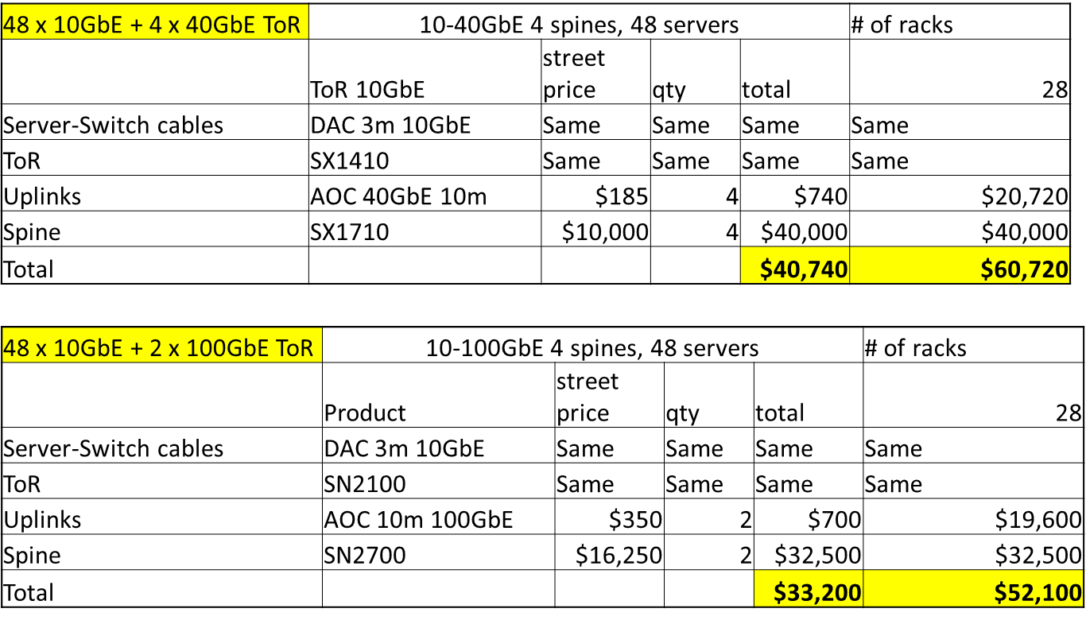

How Does 100GbE Saves Money When Running 10GbE Hosts
Why does it work?
100GbE is priced ~1.5X than 40GbE
10GbE ➔ 100GbE ToR Saves $
Want to optimize? 16 x QSFP with split cables
Save $ on Leaf-Spine AoC (<2.5X)
Opex: Less space, power
50% optics
Additional saving at higher scale
Additional savings with lower oversubscription

Slide 6
100GbE is Happening!!!

Slide 7


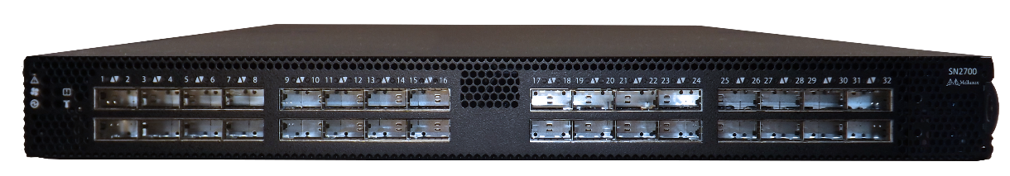
Medallia Runs 40GbE Servers to 100GbE Fabrics in Production
"For us, Cumulus is about choice and transparency.
There is a large number of whitebox and britebox vendors of Cumulus compatible switches, which allows us to pick the best and most capable hardware that fits our needs and our budget.
For the 100GbE generation, that choice was clear. As we run distributed real-time analytics, we need predictable and repeatable port-to-port performance without any surprises or exceptions. After extensive testing, the clear winner for us was the Mellanox Spectrum.“
Thorvald Natvig, Medallia lead architect

Slide 8


University of Cambridge Runs 40➔100GbE in Production
University of Cambridge has done the math and selected the Mellanox Spectrum SN2700 Ethernet switches for its OpenStack-based scientific research cloud. Why? 100GbE is there to unleash the capabilities of the NexentaEdge Software Defined Storage solution which can easily stress a 10/40GbE network.

Slide 9

SysEleven Runs 100GbE
“But what is now a switch or router? Actually, this is pretty much a PC with many network interfaces. Do not you believe me? I have here a pic from the interior of exactly such a modern Mellanox switches”
SysEleven successfully ran 32K routes over Spectrum + Cumulus Linux, they used Bird - their preferred L3 stack

Slide 10
Performance Considerations
Buffering is key at these speeds
  Huge buffers come at high price and might create unnecessary networking delays
  Buffer should be adequate to deal with DC workloads
  Single shared buffer eliminate fairness issues
Storage is getting faster every day with fast SSD and post-SSD technologies
  ToR should run reasonable cut through latency in order not to become the bottleneck
Spine switches handle a lot of traffic and must not slow down the network
  Spine should run at full line rate when there is no congestion

Slide 11
Do The Math and Don’t Forget…
Compare the entire 10/40GbE fabric cost to 10/100GbE alternative
  Cost includes all components: cables, optics, support, licenses
Break-out cables reduce cost by 35-25%
  QSFP-to-4xSFP cable costs less than 4 standard cables
100GbE Optics cost less than 2.5x 40GbE Optics
  True for transceivers as well AoCs
Measure the value you get with 100% standard protocols
  Avoid “vendor specific” features

Slide 12
Do The Math and Don’t Forget…
Not all 100GbE switch solutions are equal
  Understand the differences between various 100GbE switch solutions in the market
  The following performance analysis provides a good view of the market’s available options
$/GbE is the best way to measure network efficiency
  100GbE is significantly more cost effective,
Hyperscale network design concepts makes sense even at small scale deployments
  Web Scale IT is a force multiplier, regardless of data center footprint

Slide 13
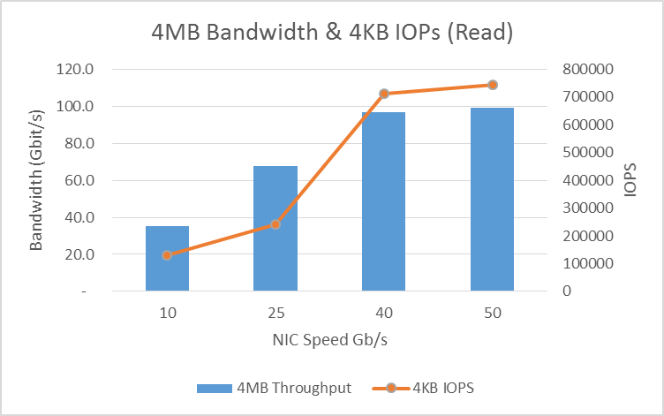
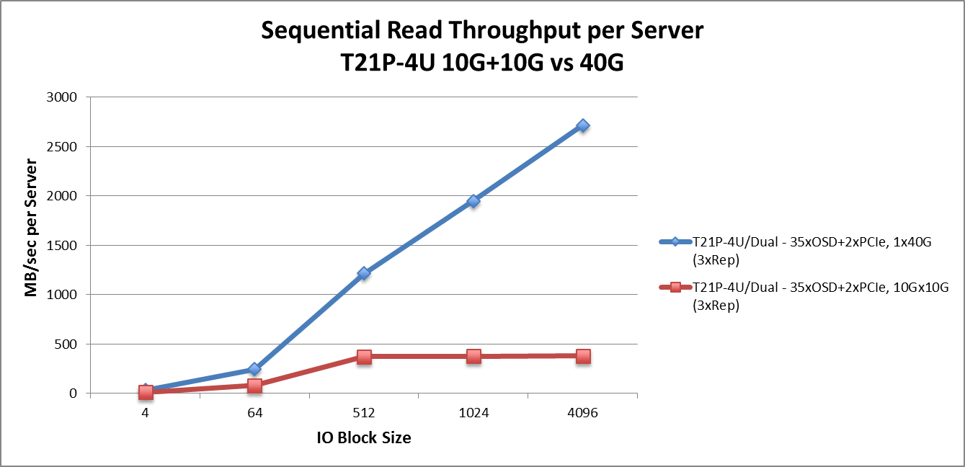

10GbE is Common, But 25/50GbE is Happening!
Mellanox Testing 10/25/40/50 GbE
Quanta Testing – Mellanox 40GbE vs. Intel 10GbE
2x more throughput, 1.8x more IOPS with 25GbE
Up to 5x better reads with 40GbE
Up to 70 Gb/s with 100GbE

Slide 14






More Software options Every Day…
Supported Operating Systems
Coming Soon (public)
More coming soon

Slide 15


Switch is Indeed a Server with Many Ports!!!
Basics - Kernel 4.4
  MAC addresses, IP addresses, MTU, admin-status (UP/DOWN), operation status (RUNNING)
  ethtool: port counters, FW version, LEDs
  VLAN filtering (vconfig)
  Promiscuous mode
  Temperature and fans
Layer 2 – Kernel 4.5
  Bridges and flooding control
  FDB, FDB learning and ageing time
  802.1Q bridges and PVID
  802.1D bridges
  Bond offload
  Team offload
  STP
  LLDP
  IGMP snooping
System – Kernel 4.6
  Introducing devlink
  Port-splitter
QoS – Kernel 4.7
  DCB and port QoS mapping
L3 - Kernel 4.8/4.9
  IPv4/v6 Routing
  ECMP

Slide 16
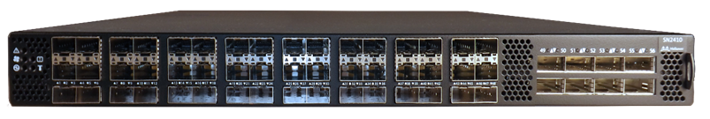
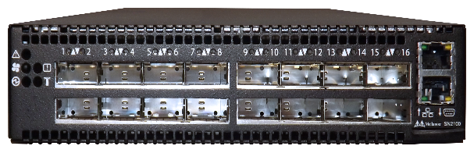

Open Ethernet Spectrum Switch Portfolio
SN2700 – 32x100GbE (64x50GbE)
Ideal 100GbE ToR / Aggregation
SN2410 – 8x100GbE + 48x25GbE
25GbE ➔ 100GbE ToR
SN2100 – 16x100GbE ports
Ideal storage/Database Switch
Highest 25GbE Density per rack unit
Notes:
Our switch portfolio is built for agility and performance. We can build the world’s largest and strongest data center solutions with our HW and SW capabilities while allowing the easiest price entry point into the network with the SX1012 and nearly unlimited growth potential with the capacity of 4Tb/s of our ASIC.

Slide 17
Thank You

